Slide 1






















1. Blue-Print
ㅍ
Production
Plan/Control
Warehouse Management
Transportation Management
SCM/ERP
(Demand Forecasting)
3. WMS
TMS
(Dispatch Planning)
TMS Partner
(Dispatch Execution)
WMS
Outbound Order
Inbound and Outbound Orders
Dispatch Order
Dispatch Information
- Create Load ID
- Dispatch Allocation
- Transportation Management
- Transportation Monitoring
- Transportation Coset Settlement
- Vehicle Sourcing
- Dispatch Execution
- Transportation Cost Billing
Production
Order
Pick
Pack
MES
(Production Performance)
Dispatch /
Loading Instructions Delivery
1. Inbound
WCS
Truck scale-based
Inbound/Outbound
Inbound Receiving Inspection
I/F
Customer
Driver
Partner
Vehicle Entry
Confirmation
2. Outbound
Outbound Staging
Loading
Picking/Loading Instructions
KIOSK Printing
Entrance LED Display
Area A LED Display 09:10
DOCK LED Display
G12-34567
25801 Loading A01
44223 Loading A02
12345 Loading A03
A01
A02
A03
Move to Area C
23492 Waiting (05)
34564 Waiting (30)
67766 Waiting (20)
25807
44228
12349

Slide 2
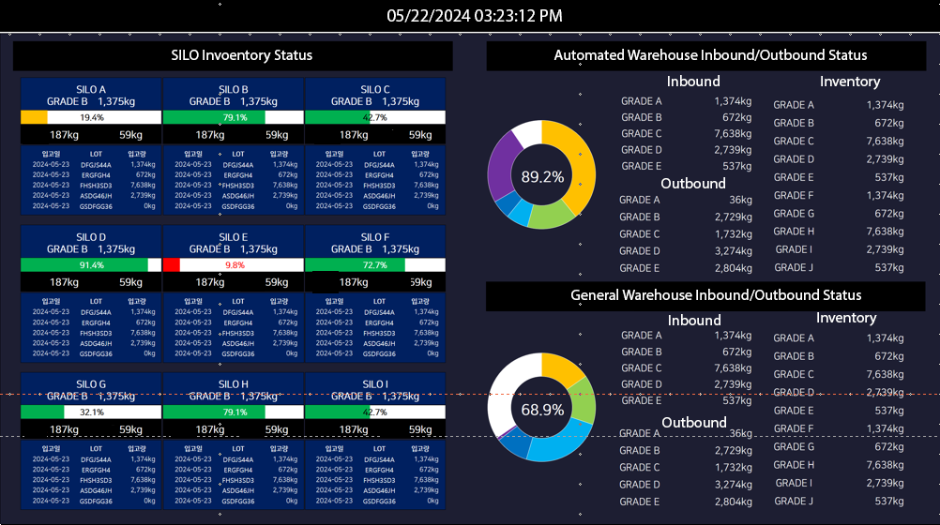
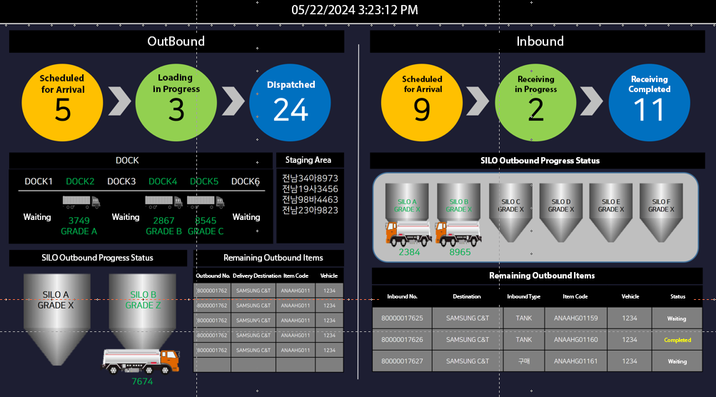
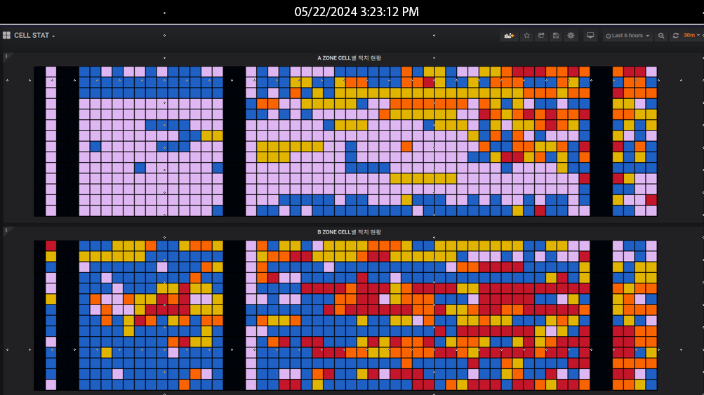
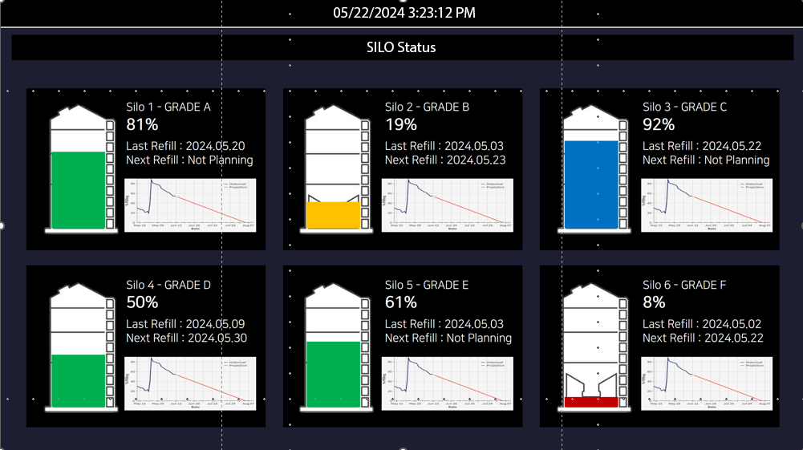
2. Dashboard
Provision of a Smart Logistics Integrated Monitoring Dashboard
We provide a real-time dashboard for an at-a-glance view of logistics status, including inventory, inbound, outbound,
and dispatch operations.
Real-Time Operations Overview
Key Highlights
Integrated Logistics KPI Summary
- Real-time aggregation of key logistics KPIs such as inventory,
inbound, outbound, and dispatch data for effective
performance management.
Customizable Targets and Management Options
- Set performance goals based on annual, quarterly, or monthly
business plans and management standards.
- Provides flexible management options for multi-dimensional
performance analysis.
“Building a Visual Dashboard
for Integrated Logistics Monitoring”
Inventory Status
Inbound/Outbound Status
Expected
Benefits
Real-time visibility enables immediate on-site
actions and issue prevention
Enhances situational awareness and communication
among logistics personnel
Identifies and improves inefficiencies in operational
workflows
Supports efficient utilization of logistics resources
Enables optimized inventory management and
logistics scheduling
Warehouse Status
SILO Status

Slide 3








3. Inbound Process
Establishing and Efficient Vehicle Control and Real-Time Inbound Processing System.
Entry Guidance/Instructions
Gate Access
LED Display
Inbound Registration
Inventory Registration
Entry
Guidance
LPR Vehicle
Recognition
LED Display
Tanker Truck
Truck Scale
SILO
Tare Weight
Inbound
Performance
Inbound
Inspection
Inventory
Registration
1. Gate Entry Management(Vehicle Admission)
2-1. SILO – Inbound Weighing
3-1. SILO – Outbound Weighing
4. Inbound Inspection
□ LPR-based Vehicle Entry Recognition> LED Display
□ Tanker Truck > Truck Scale(First Weighing) > (LED) SILO Guidance
□ SILO > Unloading > Truck Scale(Second Weighing)
□ Samling & Quality Control Testing
Tanker Truck
05/16 10:03
14F98765
Move to Area A
5. WMS(Inbound Performance)
□ Second Weighing / PDA-Based Inbound Confirmation
Cargo Truck
Warehouse
Transfer
Raw Material
Warehouse
Mobile
Inbound
Performance
2-2. Warehouse - Unloading
3-2. Warehouse - Inbound
Cargo Truck
05/16 13:04
12T45678
□ Cargo Truck > Raw Material Warehouse Assignment
□ Raw Material Warehouse > Unloading
- Mobile (Android, PDA/Tablet)
- Barcode Issuance
6. ERP(Inventory Registration)
Move to Area C
□ ERP I/F & Quality Result Update
※ Recommendation : Use PDA USIM

